Slide 1
Sniffing the Network (Programming with Libpcap)
Dr. Yingwu Zhu

Slide 2
libcap
A portable C/C++ library for network traffic capture
http://www.tcpdump.org/

Slide 3
Packet handling on Ethernet
Upon receiving a Ethernet frame, the network card checks its destination MAC
If it matches its own, the card generates an interrupt
The network card driver handles the interrupt
Timestamp the received data
Copy it to the kernel buffer
Determine the packet type by checking the ether-type field in the frame header
Pass it to the appropriate protocol handler in the protocol stack

Slide 4
Packet handling on Ethernet (2)
If IPv4 datagram is contained, the IPv4 packet handler
Perform error check
Make sure it is for this host
Remove the IP header, pass it to the next protocol handler, say TCP

Slide 5
Sniff Packets
A packet sniffer go through the same process
The network driver also sends a copy of the received or transmitted packet to a part of the kernel: packet filter
The packet filter makes packet capture possible!
By default they let any packet through
We can specify a filter (using filtering capability)
Require admin privileges

Slide 6
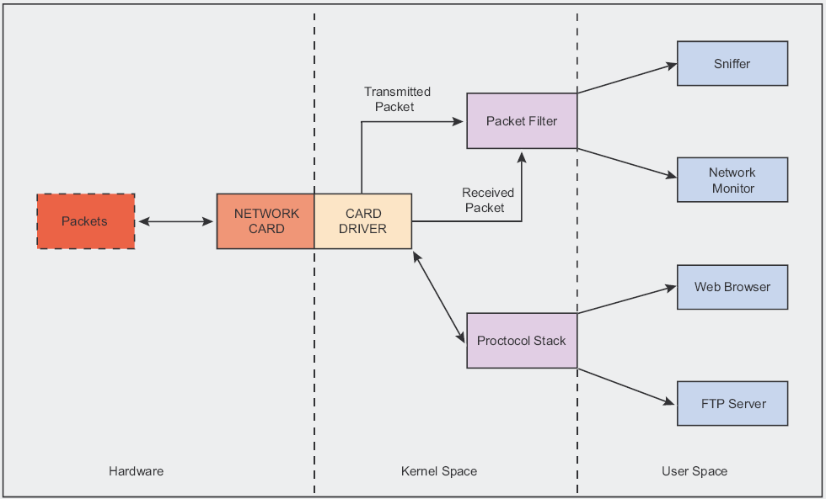

Slide 7
Important things for packet sniffer
1. Data link type
Different tech. and standards operating at the data link layer
The sniffer must know the underlying data link type, thus to correctly interpret the headers used in the layer
Pcap_datalink(pcap* p)
Returns the link type of the device

Slide 8
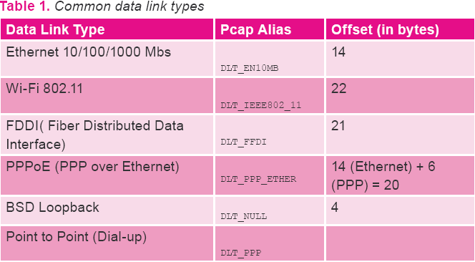
Offset: the start of the captured data to get the next protocol header

Slide 9
Important things for packet sniffer (2)
2. Network layer protocol
How?
The Ethernet header has a 16-bit ethertype that specifies the next protocol (network-byte order)
/* Ethernet header */
struct sniff_ethernet {
u_char ether_dhost[ETHER_ADDR_LEN]; /* destination host address */
u_char ether_shost[ETHER_ADDR_LEN]; /* source host address */
u_short ether_type; /* IP? ARP? RARP? etc */
}; //14 bytes for Ethernet frame header

Slide 10
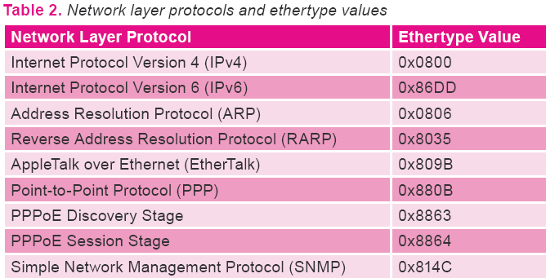

Slide 11
Important things for packet sniffer (3)
3. Transport layer protocol
If it is IPv4 datagram, a quick look on the protocol field of the IP header will know the transport layer protocol
/* IP header */
struct sniff_ip {
u_char ip_vhl; /* version << 4 | header length >> 2 */
u_char ip_tos; /* type of service */
u_short ip_len; /* total length */
u_short ip_id; /* identification */
u_short ip_off; /* fragment offset field */
#define IP_RF 0x8000 /* reserved fragment flag */
#define IP_DF 0x4000 /* dont fragment flag */
#define IP_MF 0x2000 /* more fragments flag */
#define IP_OFFMASK 0x1fff /* mask for fragmenting bits */
u_char ip_ttl; /* time to live */
u_char ip_p; /* protocol */
u_short ip_sum; /* checksum */
struct in_addr ip_src,ip_dst; /* source and dest address */
};
#define IP_HL(ip) (((ip)->ip_vhl) & 0x0f)
#define IP_V(ip) (((ip)->ip_vhl) >> 4)

Slide 12
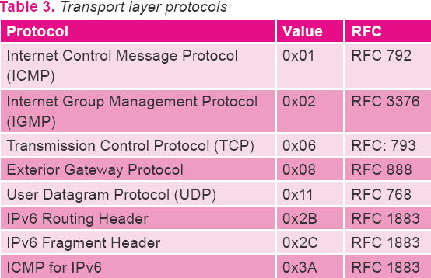
http://www/.iana.org/assignments for complete list

Slide 13
Important things for packet sniffer (4)
4. Application layer protocol
A bit harder to distinguish because the TCP header does not provide any info about the payload it transports
-- But port # could provide a useful clue

Slide 14
Malformed Packets
The packet sniffer must handle malformed packets!
Fact #1: An ethertype (for ARP) does not mean we’ll find an ARP header
Fact #2: We cannot trust the protocol field of IP datagram to contain the correct value for the following header

Slide 15
A good packet sniffer
Check the whole size of the received packet
ARP packet (14+28 = 42), different size packets have to be discarded
Check IP & TCP checksums (corrupted to be discarded)
Check encoding
HTTP & SMTP: text oriented
TCP/IP: binary format
Any data extracted for later use should be validated
If the payload of a packet contains an IP addr, check it is a valid IP addr!

Slide 16
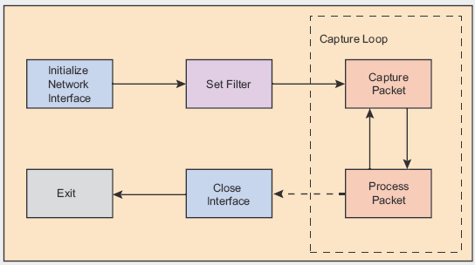
Programming with Pcap - Normal program flow of a pcap application

Slide 17
The Pcap Application
Determine which interface we sniff on
Initialize pcap
Tell pcap what device we are sniffing on
Set filter
Sniff on specific traffic
E.g., only TCP/IP packets, only packets going to port 23
Capture loop
Process captured packets
Close

Slide 18
Data Encapsulation in Ethernet Networks using the TCP/IP protocol

Slide 19
Determining the Device
char *pcap_lookupdev(char *errbuf)
returns a pointer to a network device
If there is an error, NULL is returned and errbuf is filled in with an appropriate error message

Slide 20
Look up device
int pcap_lookupnet(const char *device, bpf_u_int32 *netp, bpf_u_int32 *maskp, char *errbuf)
determine the network number and mask associated with the network device device. Both netp and maskp are bpf_u_int32 pointers.
A return of -1 indicates an error in which case errbuf is filled in with an appropriate error message.

Slide 21
Opening the device for sniffing
pcap_t *pcap_open_live(char *device, int snaplen, int promisc, int to_ms, char *ebuf)
snaplen: an integer which defines the maximum number of bytes to be captured by pcap
promisc: set to true, brings the interface into promiscuous mode
to_ms is the read time out in milliseconds

Slide 22
Filtering the traffic
int pcap_compile(pcap_t *p, struct bpf_program *fp, char *str, int optimize, bpf_u_int32 netmask)
2nd para: a reference to the place we will store the compiled version of our filter.
3nd para: filter expression in string format
int pcap_setfilter(pcap_t *p, struct bpf_program *fp)
Apply the compiled filter

Slide 23
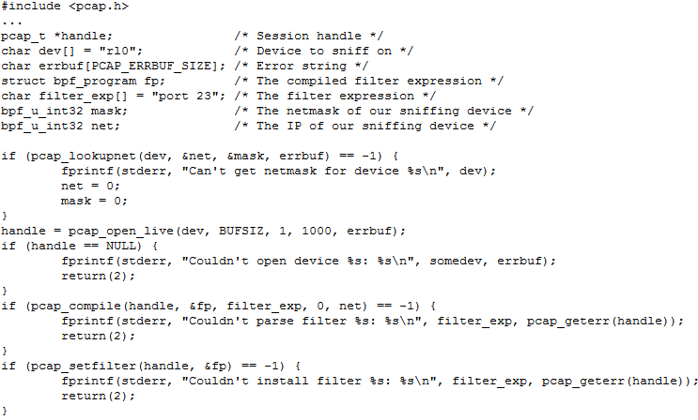

Slide 24
Actual sniffing (I) - capturing single packet at a time
u_char *pcap_next(pcap_t *p, struct pcap_pkthdr *h)
struct pcap_pkthdr {
struct timeval ts; /* time stamp */ bpf_u_int32 caplen; /* length of portion present */
bpf_u_int32 len; /* length this packet (off wire) */
};

Slide 25
A simple sniffer

Slide 26
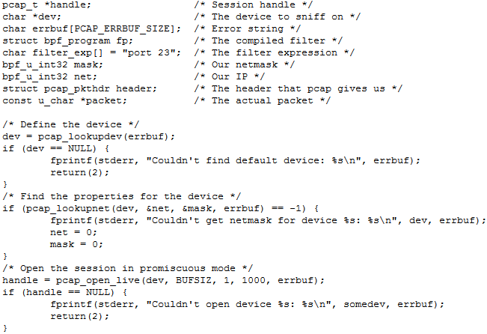

Slide 27
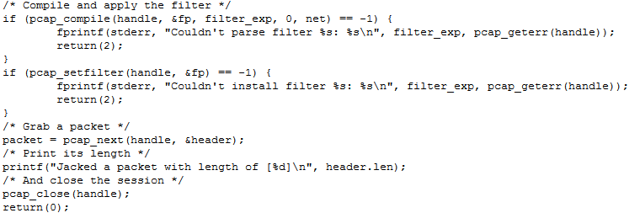

Slide 28
Actual Sniffing (II)
Enter a loop that waits for n number of packets to be sniffed before being done
int pcap_loop(pcap_t *p, int cnt, pcap_handler callback, u_char *user)
The last argument is set as NULL most time
void got_packet(u_char *args, const struct pcap_pkthdr *header, const u_char *packet);
Callback function
1st arg: corresponds to the last arg in pcap_loop()
2nd arg: pcap header
3rd arg: points to the first byte of a chunk of data containing the entire packet, as sniffed by pcap_loop().

Slide 29
Structure definition used to describe TCP/IP over Ethernet

Slide 30
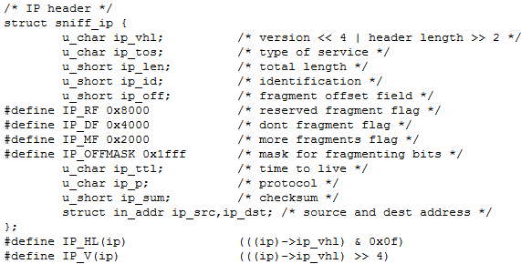
Structure definition used to describe TCP/IP over Ethernet

Slide 31
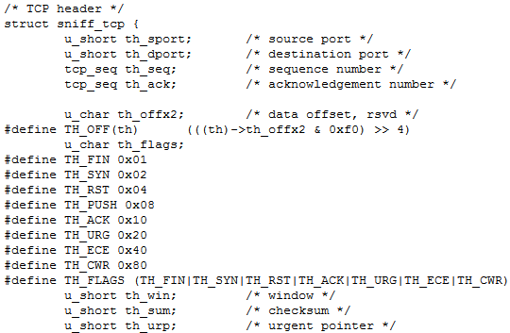
Structure definition used to describe TCP/IP over Ethernet

Slide 32
